Slide 1
Powder Springs Elementary School
ESOL Open House
English for Speakers
of Other Languages
PSE ESOL Blog
http://psesol.weebly.com/
ESOL Teachers
Kelly Williams: Kindergarten, First, and Fourth Grades
Alice Sodjago: Second, Third, and Fifth Grades

Slide 2
Powder Springs Elementary School Mission: Invest, Inspire, Innovate with Integrity Vision: Investing in tomorrow by engaging creative minds today. CCSD ESOL Program Mission: Cobb County School District (CCSD) ESOL Program mission is to help ensure the English language development and academic success of English Learners (ELs). Vision: To be the district leader in Georgia in ensuring the academic success of every English language learner as demonstrated by the annual increases in the percentage of children (a) making progress in learning English, (b) attaining English proficiency by the end of each school year, as determined by a valid and reliable assessment of English proficiency, and (c) making progress toward meeting academic reading and math goals for the English Learner subgroup.

Slide 3
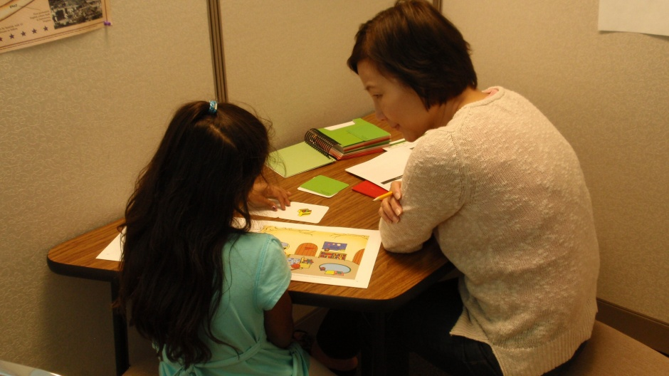
WIDA Screener
W-APT
Why was my child screened for ESOL services? She/He speaks English.

Slide 4
Summary of the ESOL Program
ESOL Students receive language support for at least 45-50 minutes every day.
ESOL teachers use language standards along with the content standards that classroom teachers use to support student achievement.
Every January-March students take the ACCESS 2.0 test to measure their progress in English language proficiency. The score on this test determines whether or not a student exits the program.
PSE ESOL Blog
http://psesol.weebly.com/

Slide 5
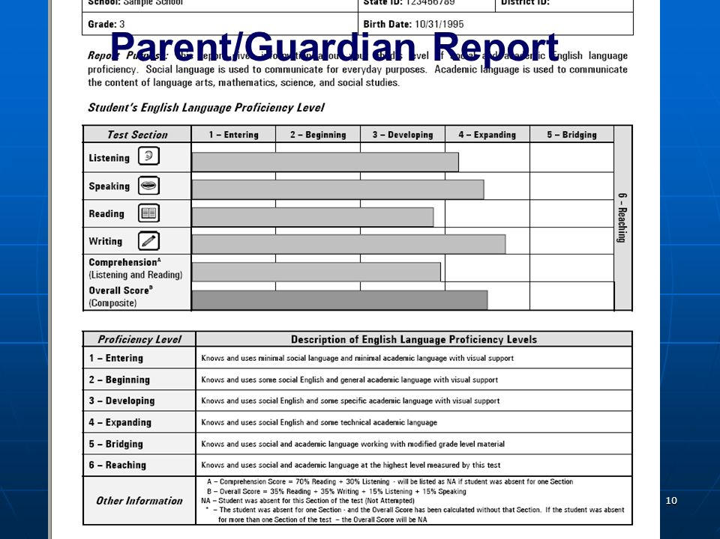
How long will my child receive ESOL services?

Slide 6
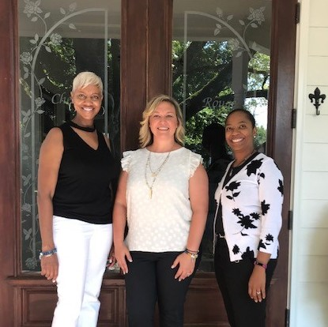
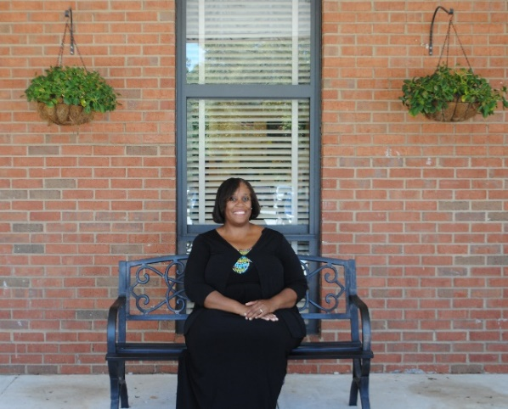
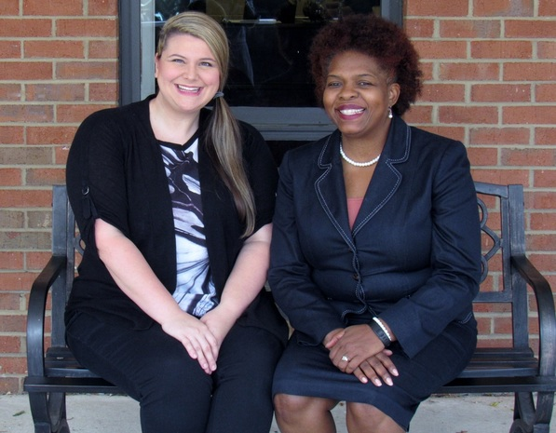
People You Should Know
Debbie Broadnax, Principal
Beth Maffei, School Leadership Intern
Kenyatta Redding Frederick, Assistant Principal
Lisa Daves, Parent Facilitator
Dr. Beth Ruff & LaShawn Thomas,
School Counselors
Notes:
Insert ESOL mission and vision here.

Slide 7
How can you stay involved?
Join PTA and attend PTA meetings. Interpreters are requested to attend all PTA meetings.
Become a parent volunteer.
Attend Curriculum Nights.
Participate in W.I.G.S.
Make sure your child is doing homework.
Notes:
L

Slide 8
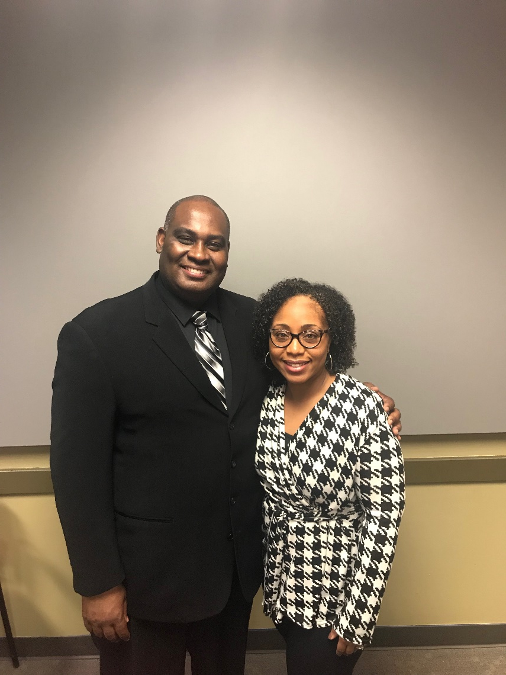
PTA and Foundation
Breeshun Crawford, PTA President
pta.pselementary@gmail.com
Danny and Latonya Wade,
Foundation President and Secretary
psefoundation@gmail.com

Slide 9
School Communication

Slide 10
What can you do to help your child?
Talk to your child.
Two languages are better than one! It is okay to speak to your child in your home language.
Read with your child. If you feel more comfortable with your home language, please read to your child in your home language. This will not delay his or her learning of English. Your child should be reading for 20 minutes or more every night.
Check your child’s agenda daily (and folder on Thursday).
Notes:
L

Slide 11
How can I find books on my child’s reading level?
Ask your child’s homeroom teacher for his/her independent guided reading level, DRA or lexile level.
Go to your local library and tell the library your child’s reading level not the grade level.
Students can use their CCSD ID# to check out books at the library.
Go to https://www.scholastic.com/teachers/bookwizard/

Slide 12
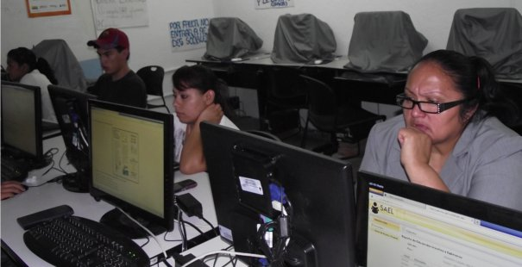
ESOL Parent Resources
Adult ESOL Classes at McEachern United Methodist Church
Classes are currently full. Please call 770-943-3008 in December
for information about January classes.
Chattahoochee Technical College--FREE GED Prep and Adult ESOL Classes
Paulding Campus 400 Nathan Dean Boulevard Dallas, GA 30132 Phone: 770-443-3615 Registration Days/Time: Monday and Wednesday from 9:00 a.m. to 12:00 p.m. and 5:00 p.m. to 7:30 p.m.
USA Learns: https://www.usalearns.org/ Learn English and become a citizen.

Slide 13
Title I
Federally funded
Based on students’ economic needs
Provides high-quality education for every child
Provides extra help to students who need it most (students who are the furthest from meeting state standards)

Slide 14
What is Funded by Title I?
Additional staff
- academic coachs
- parent facilitator
Tutoring (during school day)
Instructional materials
Technology & Software (iPads & Istation)
Professional Development
Substitute teachers
Parent workshops

Slide 15
2019-2020 PSE Priorities
Arts Integration (with integrity)- focusing on math & writing
Process boards
Vocabulary
Prioritizing & unpacking standards
Cobb Collaborative Communities
Continue parent engagement opportunities
- WIGS
- Evening Workshops
- Saturday Parent Workshops (twice/year)

Slide 16
What programs/supports are in place to help my child?
EIP & Reduced Class Models
ESOL Services
Specialized Services
Read 180/System 44
Istation
Tutoring (grade levels TBD)
RTI

Slide 17
Visit our Powder Springs ESOL Blog http://psesol.weebly.com/
Information about ESOL
Current Events
Student Resources
Parent Resources

Slide 18
Thank you for coming!
Alice Sodjago alice.sodjago@cobbk12.org
Kelly Williams kelly.williams@cobbk12.org
770-222-3746

